Slide 1
Obtaining Patent Data from
the Lens: Introduction and Practical Exercise
Manila
7 November 2017
Irene Kitsara, IP Information Officer, Access to Information and Knowledge Division

Slide 2
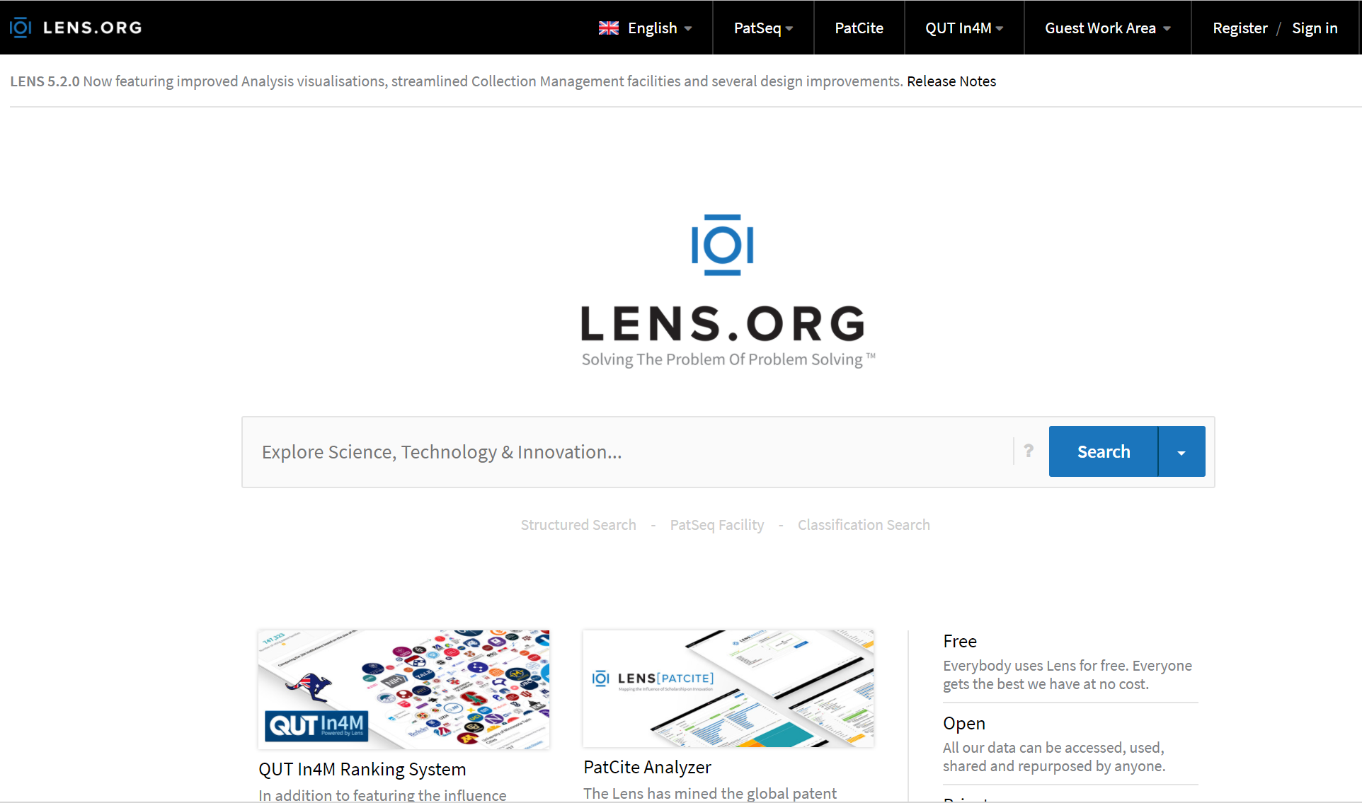
What is the Lens?
Result of collaboration between Cambia and the Queensland University of Technology (QUT)
Funded by Bill & Melinda Gates Foundation (US$1.6 million grant )
Patent/Patent Sequence Platform with NPL Data and Analysis features
https://lens.org

Slide 3
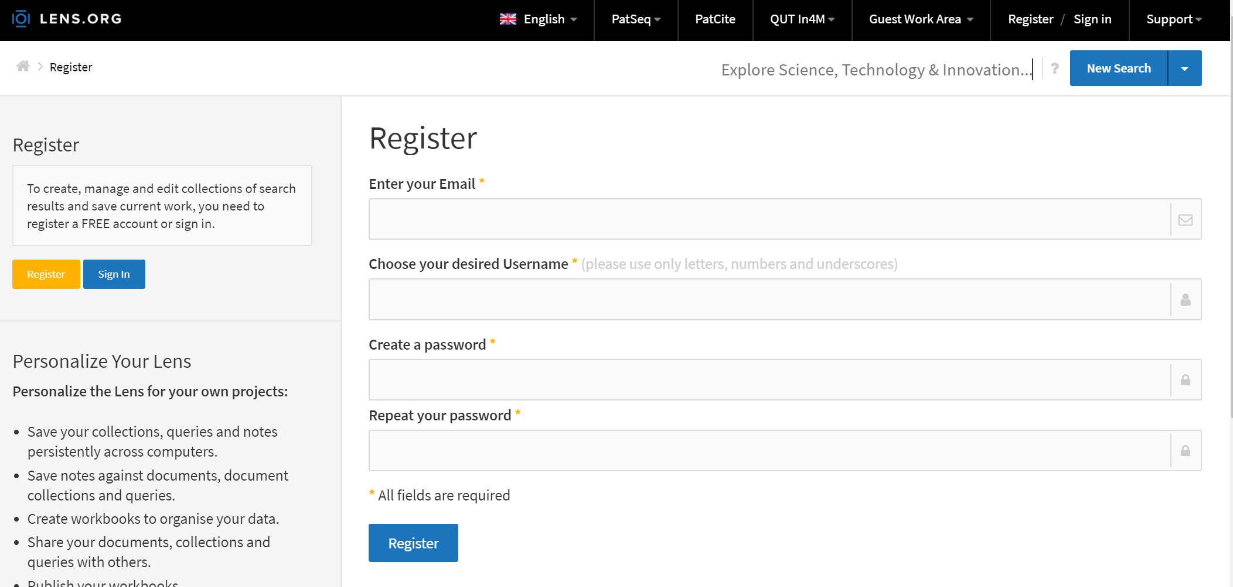
Registering @ the Lens

Slide 4
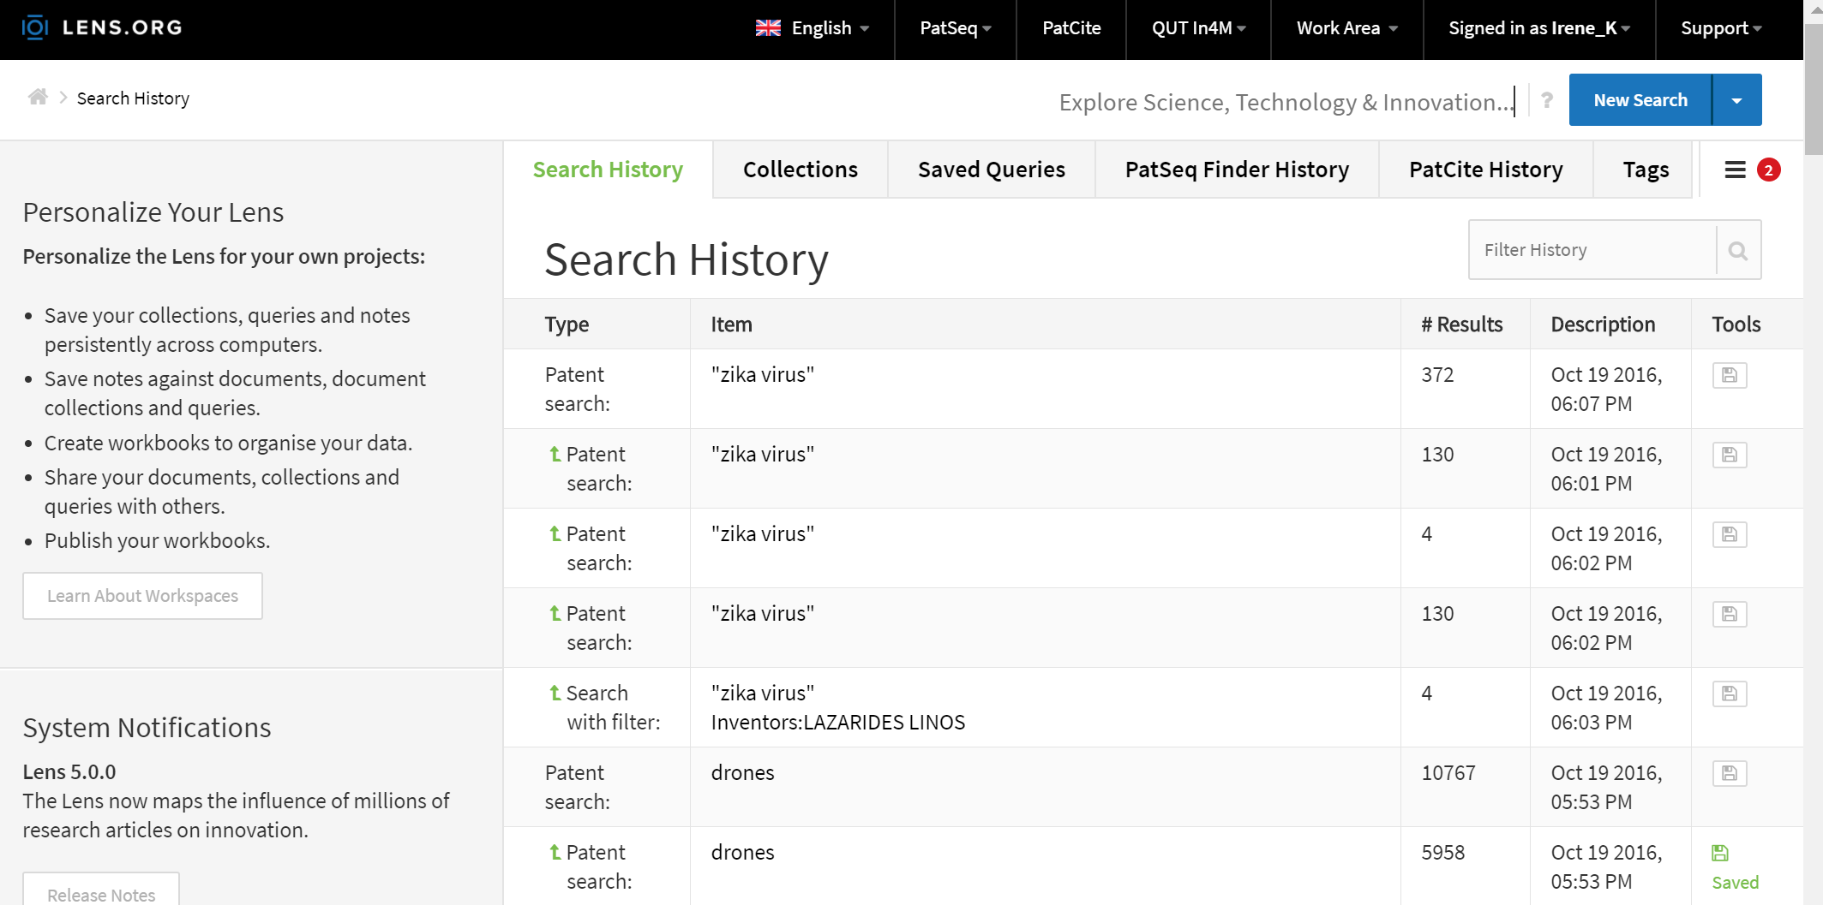
Being logged-in @ the Lens

Slide 5
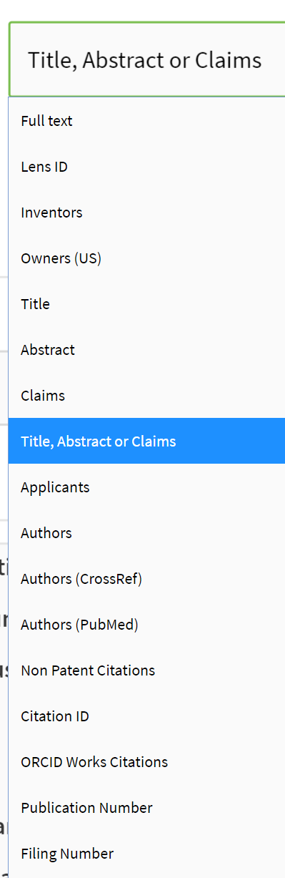
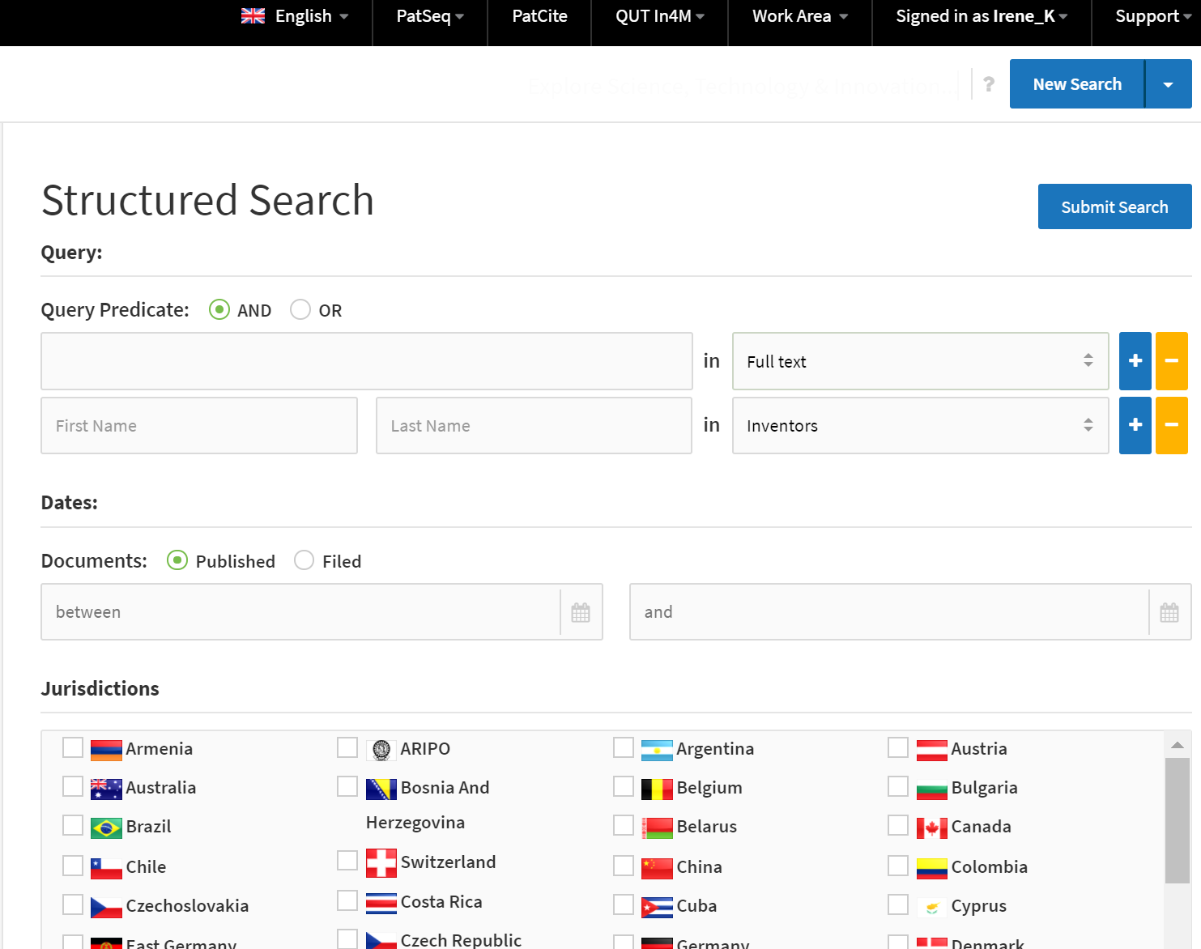
The Lens – Structured Search

Slide 6
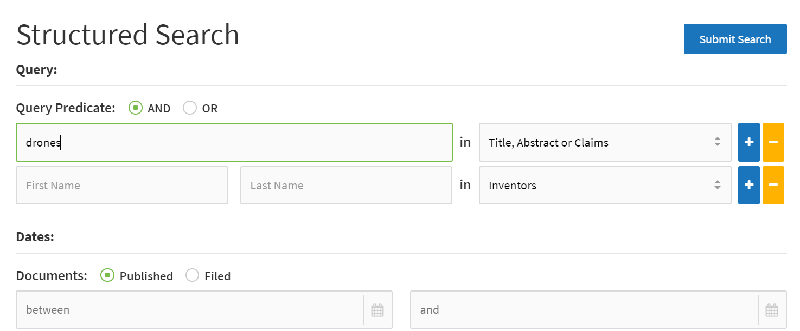
Looking for drones…in TAC

Slide 7
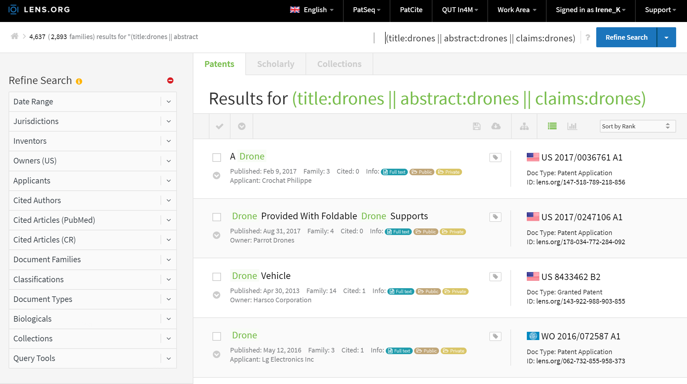
Search results for drones – simple families

Slide 8
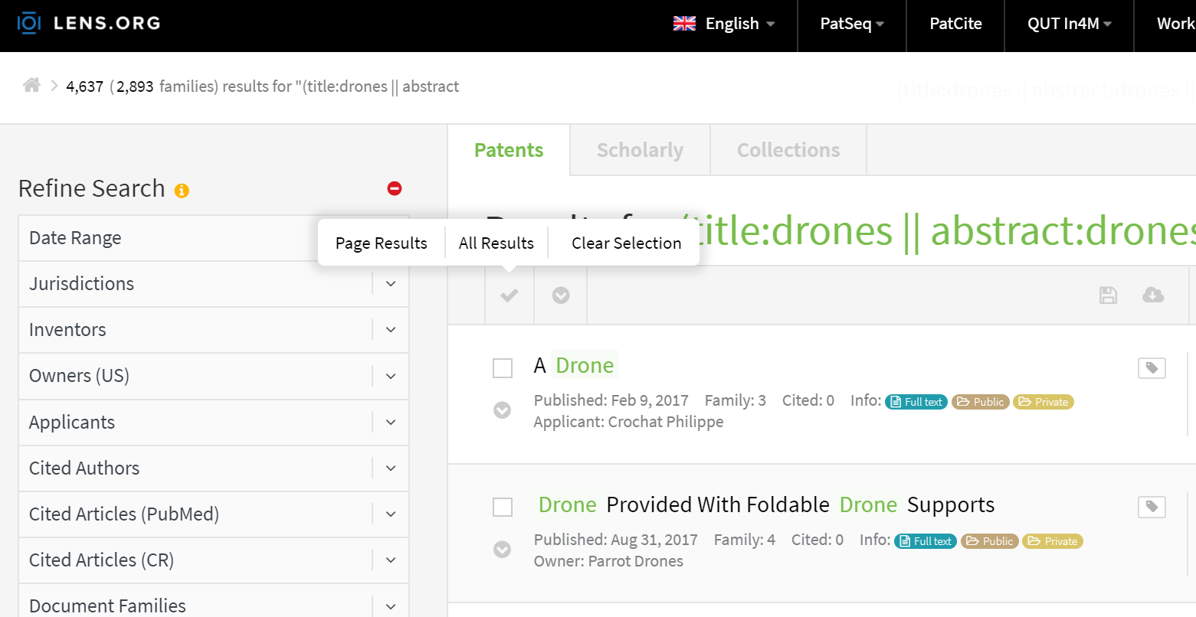
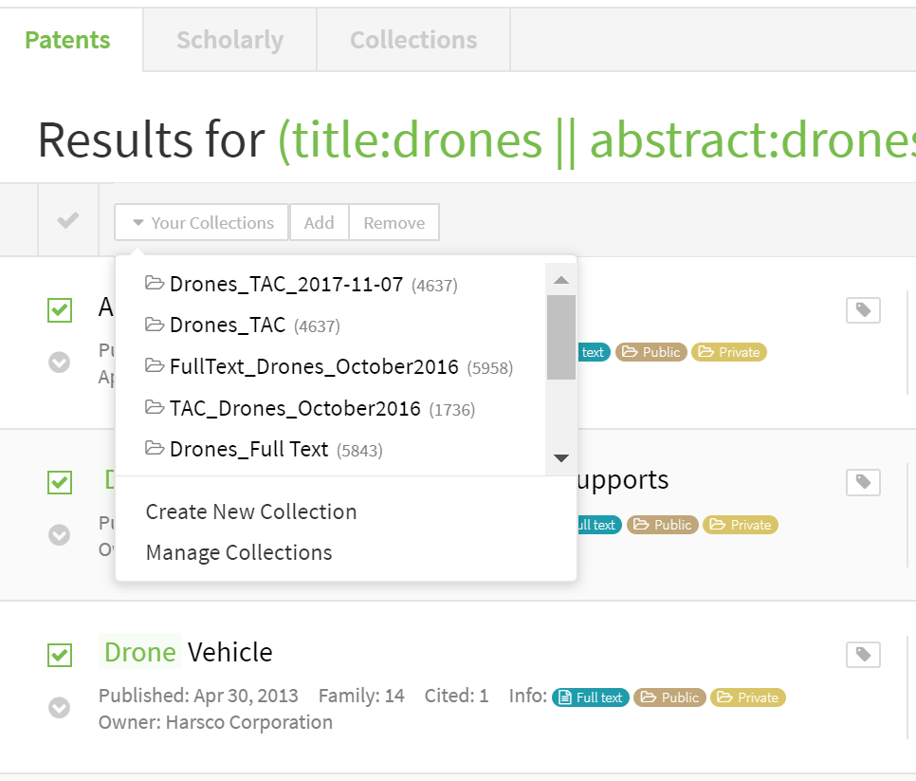
Next step: create a collection!

Slide 9
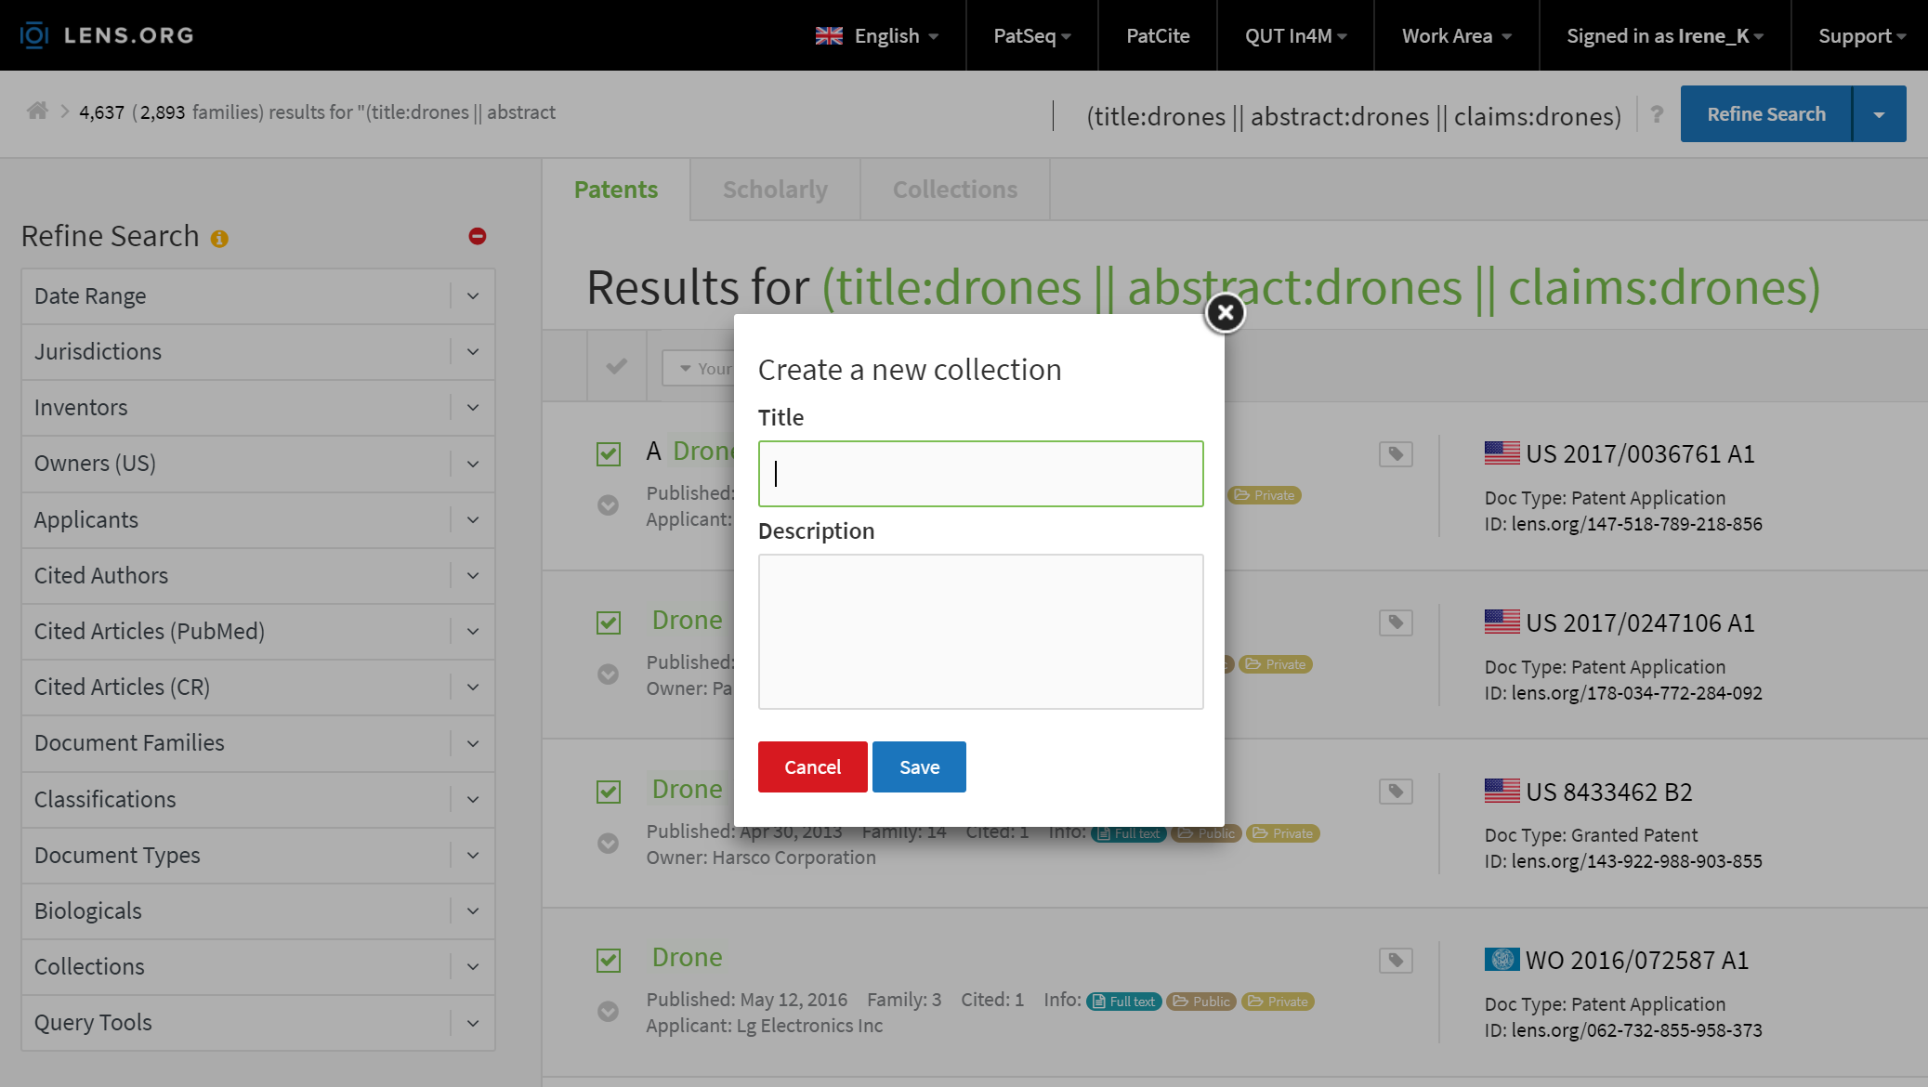
Create and save your collection

Slide 10

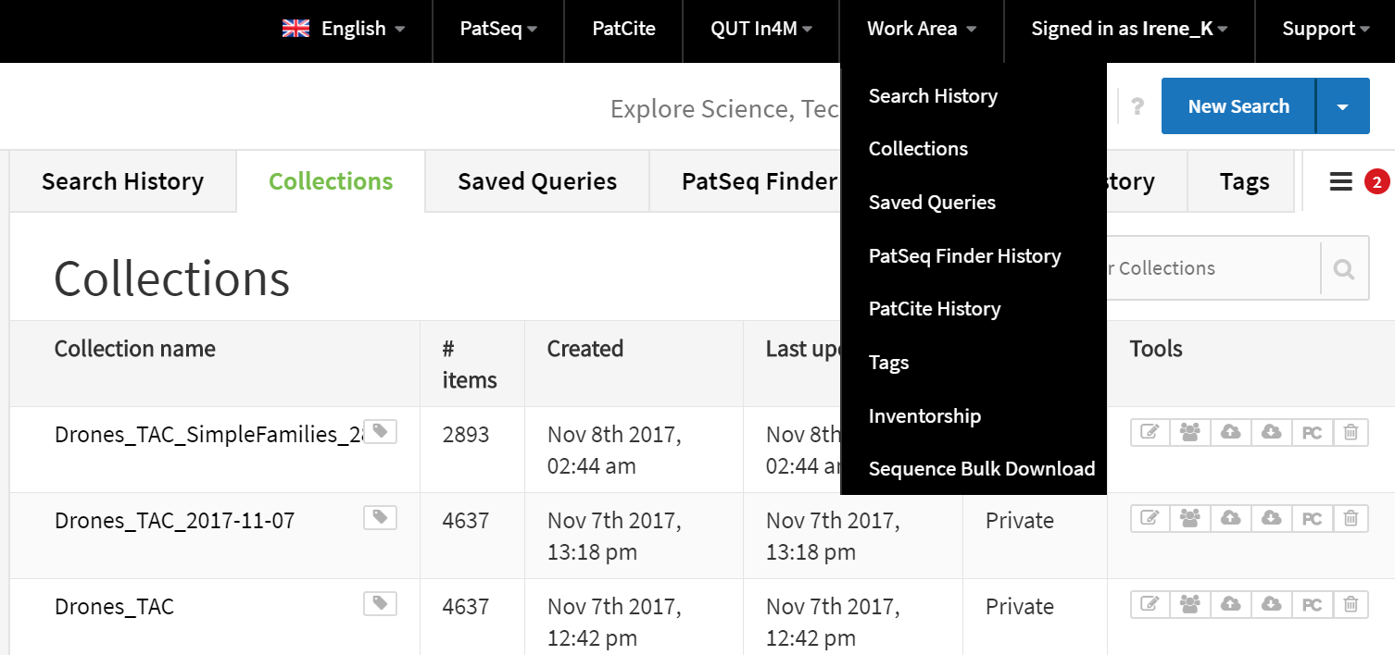
The collection is now available

Slide 11
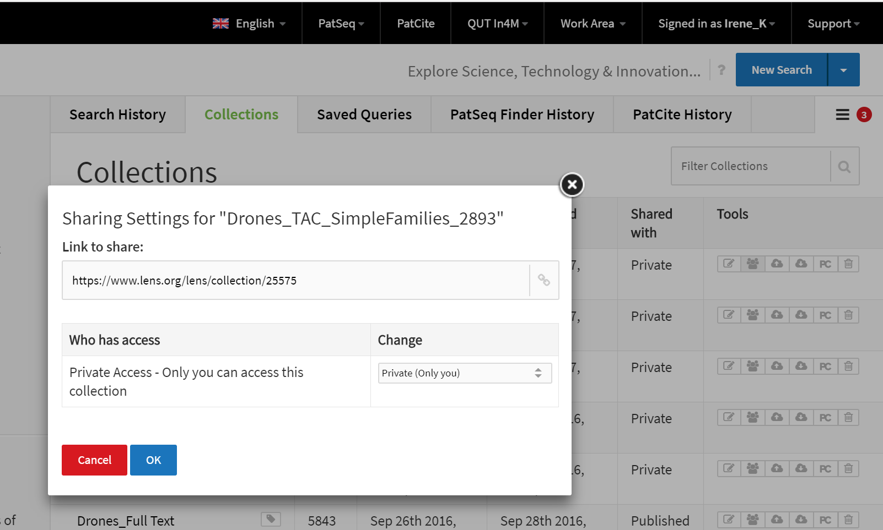
Sharing the collection – creating a link

Slide 12
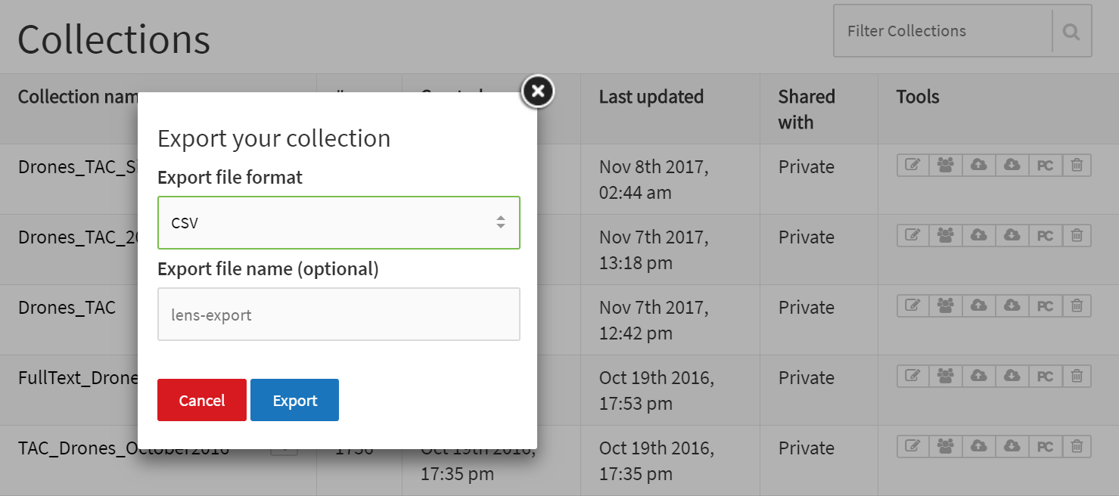
Exporting the collection (work area)
Exporting up to 10.000 collection records

Slide 13
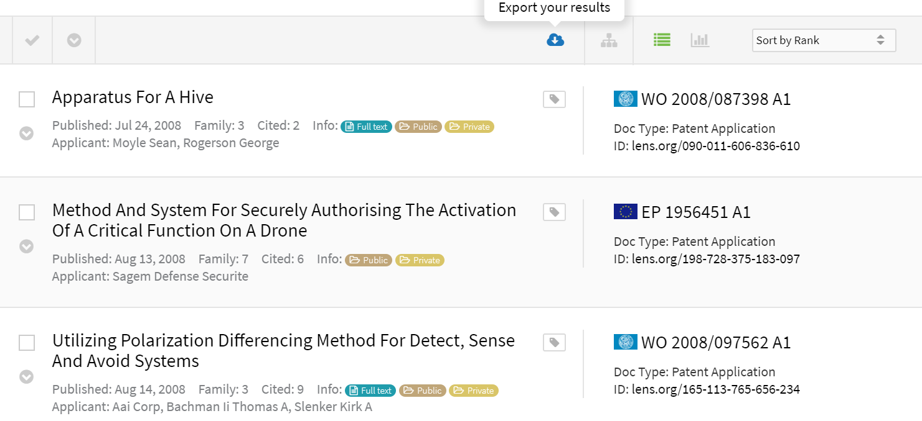
Exporting the search results
Exporting metadata for up to 1000 search results

Slide 14
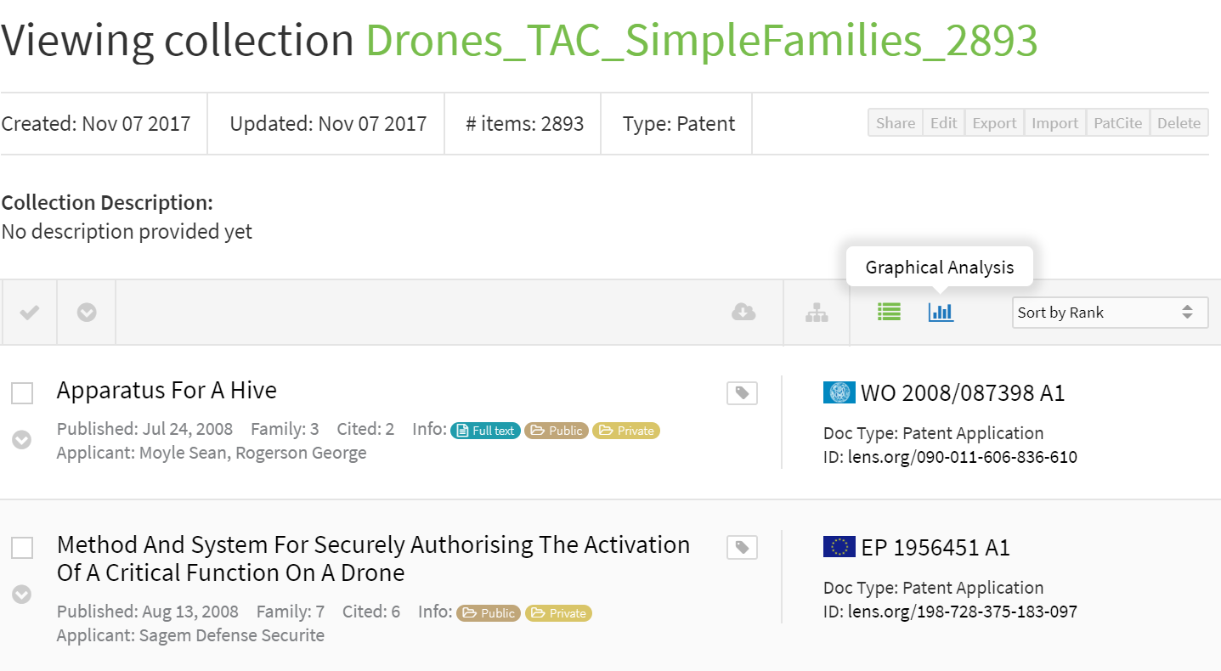
Visualizing the search results - Graphical Analysis

Slide 15
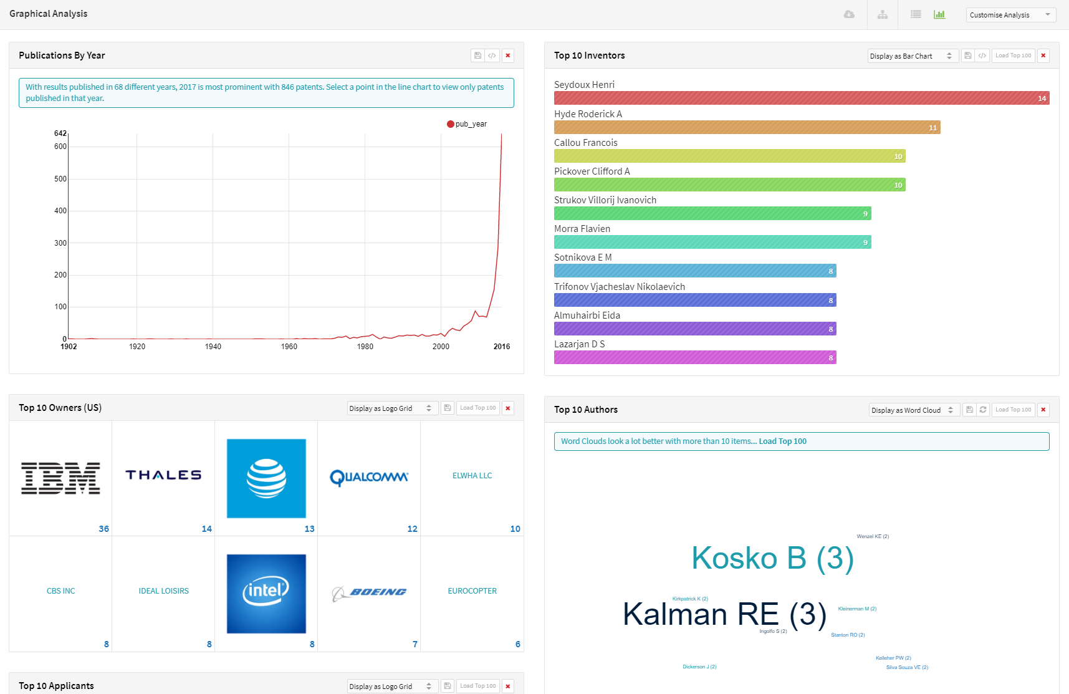
Results Visualization: Interactive Dashboard

Slide 16
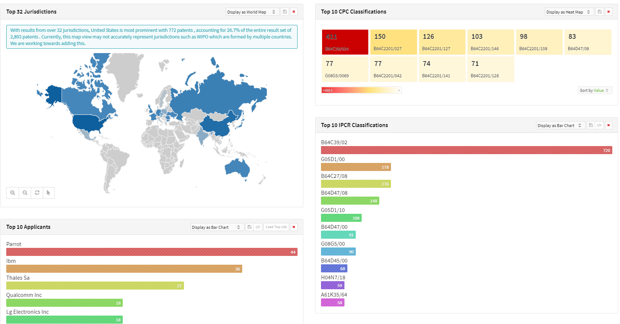
Different visualizations supported

Slide 17
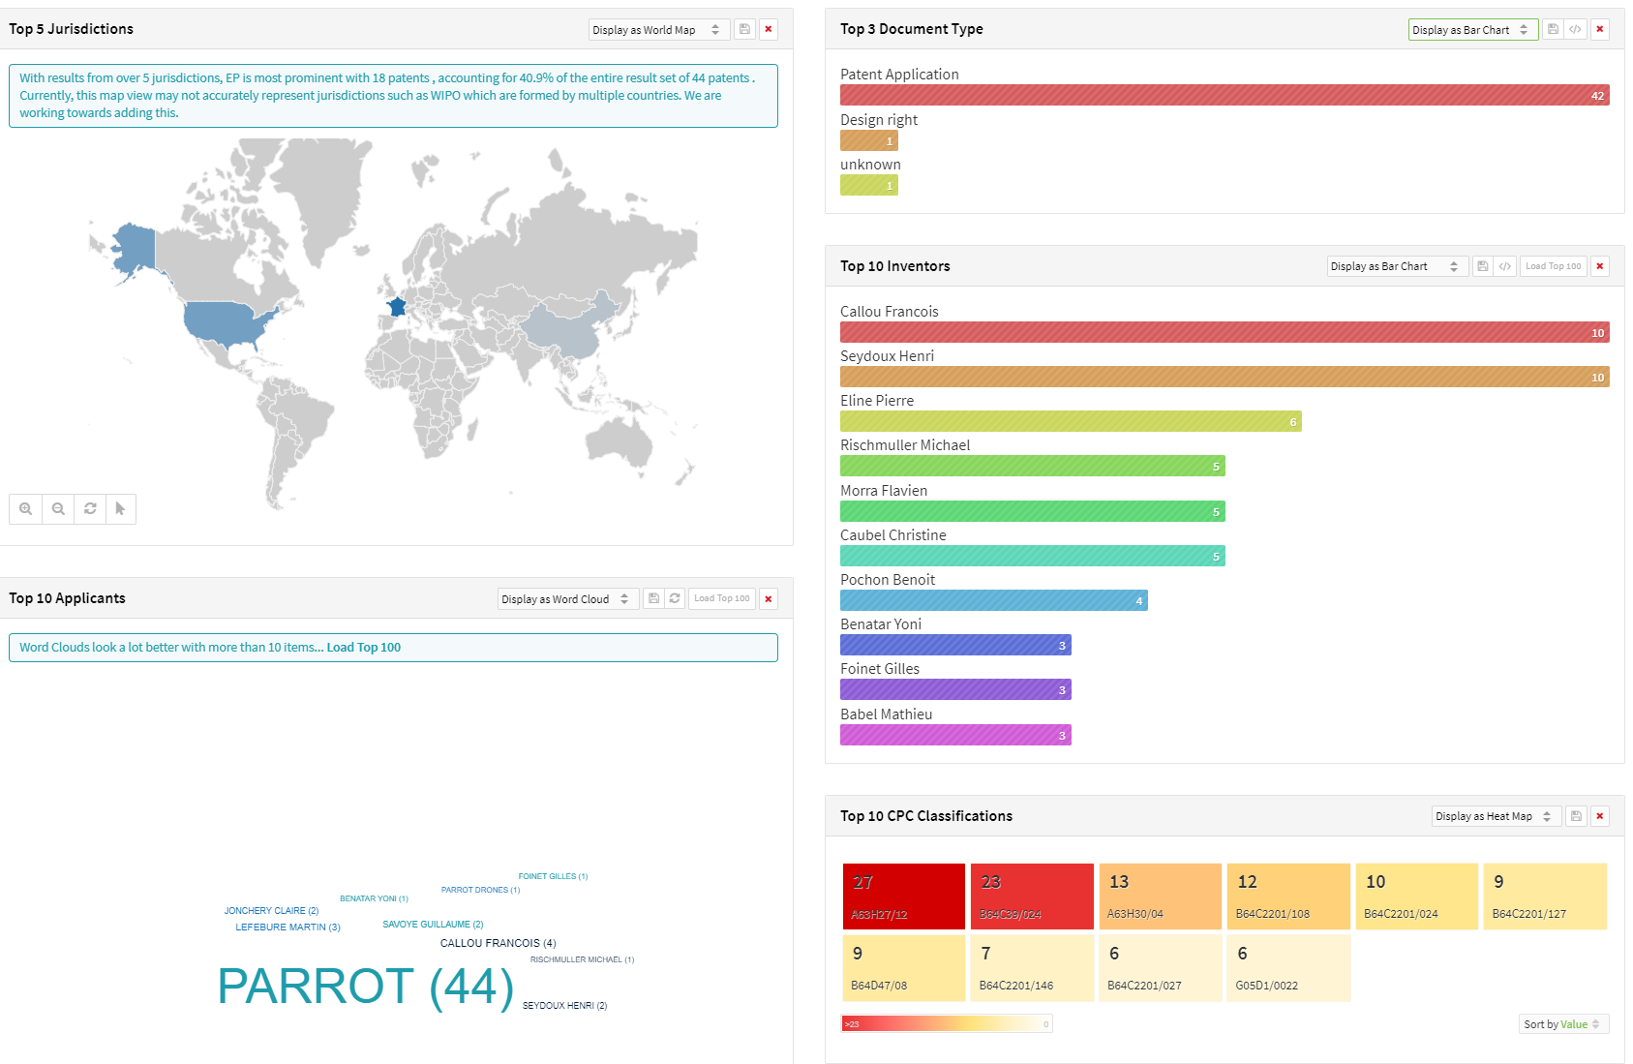
Drilling down the results of an applicant (Parrot)

Slide 18
Now…your turn
Search for “drones” in Full text
Consider a strategy for limiting the noise
What else could a “drone” be?
Create a Full text collection, export it, and share it with the colleague sitting next to you
How do you make sure to export all your results?
Go on the Lens analysis area: who is the top applicant in patent filings related to drones (FT)?
Who is the main inventor of the top applicant?

Slide 19
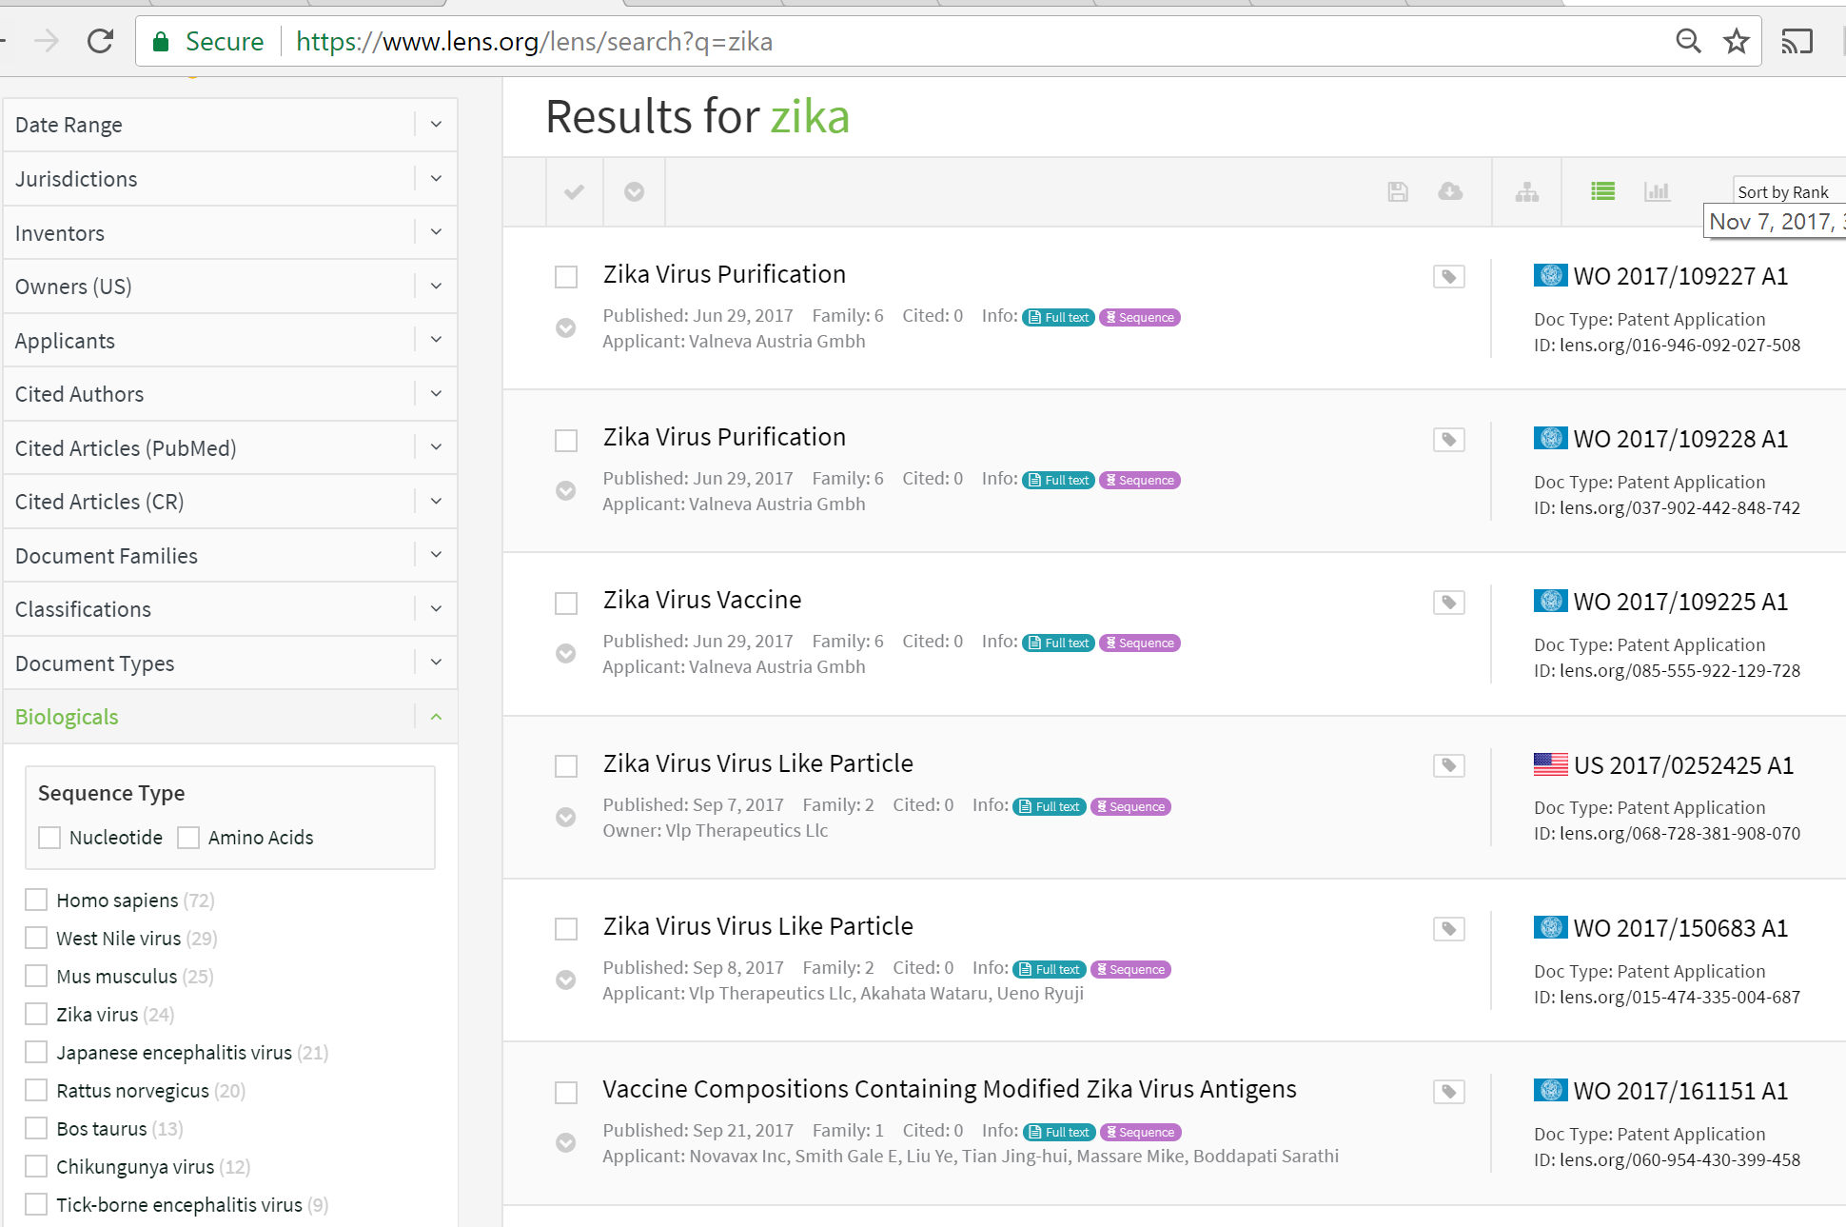
Search results and biologicals information
Search for “zika virus”
Go to the left side of your pane….

Slide 20
Thank you for your attention!
Irene.Kitsara@wipo.int

